Slide 1
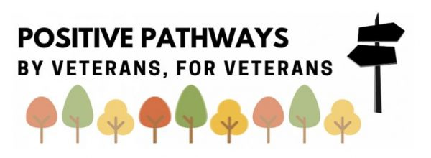

The Combat Stress Training Programme
UNDERSTANDING
WHY VETERANS MAY BE VULNERABLE TO POOR
MENTAL HEALTH
Module 2 of 4

Slide 2


WELCOME & INTRODUCTIONS
Your facilitators are Dr Jen Bateman, Lead Clinical Psychologist and Jolandi du Preez, Lead Occupational Therapist.
The webinar will be recorded and the recording shared on our ‘on-demand’ training webpage: https://www.combatstress.org.uk/CombatStressTrainingForOrganisations
We will be taking questions, please do submit these in the Q&A box and we will have a Q&A session at the end of the webinar.

Slide 3
THE COMBAT STRESS TRAINING PROGRAMME FOR VETERANS’ WELLBEING
Module 3:
Understanding & responding to veterans who may be struggling with poor mental health
Module 2:
Understanding why veterans
may be vulnerable to
poor mental health
Module 1:
Understanding wellbeing & resilience
and how to foster it
Module 4:
Building trauma informed organisations

Slide 4
OUTLINE OF TODAY’S TRAINING
Module 2: Understanding Why Veterans May be Vulnerable to Poor Mental Health
The unique culture of military and veteran life
Encountering trauma during service and early life
Supporting transition from military to civilian life

Slide 5
PART 1:
THE UNIQUE CULTURE OF MILITARY & VETERAN LIFE

Slide 6
A MOMENT TO REFLECT…
What are some of the strengths of military life?
What may be some of the vulnerabilities?

Slide 7

PAUL SHARES HIS STORY…
Paul joined the RAF in 1989, aged 20. He served for 23 years, undertaking operations in the Middle East, North Africa and Afghanistan within the military intelligence arena.
“I’d always had a fascination with aviation and aircraft. I wanted to get on a formal career path and to travel the world. I’d left school with only a handful of O-level qualifications, but the RAF spotted that I had an aptitude for learning languages. I was subsequently taught three target languages over my career to a very high level, as well as completing several masters degrees.
We’ll catch up with Paul’s story a bit later…
“During my time with the UN, I saw horrific events linked to children - it threw my world upside down. I was a new dad at the time and on return home it became apparent to me that I wasn’t the same person. However, I kept my concerns bottled up and just carried on without talking to anyone.

Slide 8
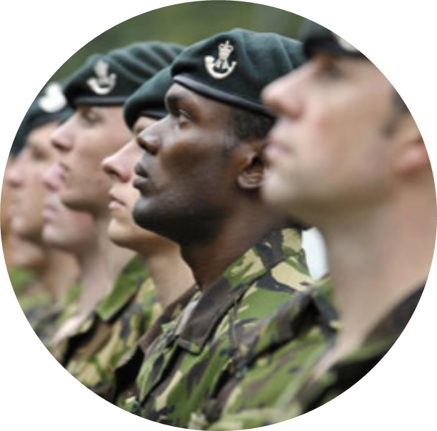
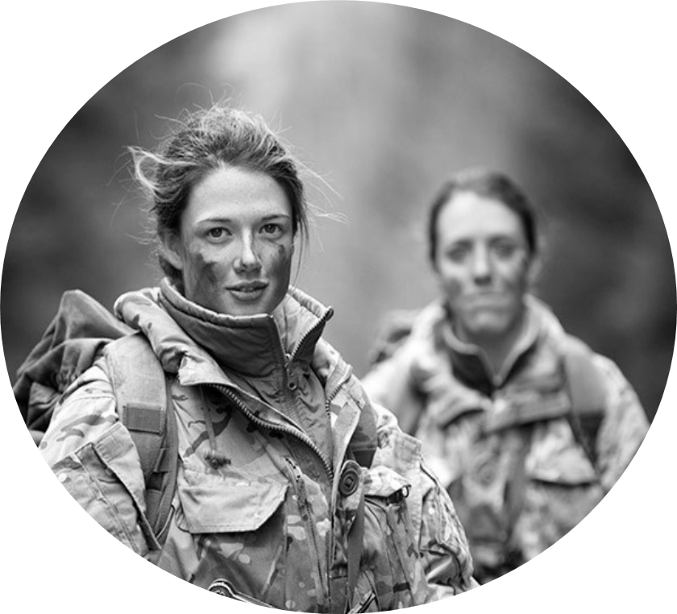
SOME KEY ASPECTS OF MILITARY CULTURE
Identity
Belonging
Collective Purpose
Shared Values
Stoicism
Humour
Camaraderie
Unit cohesion
Courage
Respect
Commitment

Slide 9
A CAREER, AN ADVENTURE
The Armed Forces provide a career for a wide and diverse group of people and recognises the wide range of skills individuals, regardless of background, have to offer
The Armed Forces provide qualifications and apprenticeships, facilitating the learning of new skills and trades.
The Armed Forces provide opportunities for high-adrenaline sport and adventure

Slide 10
A NEW IDENTITY, A CULTURE SHOCK
Assimilation into military culture is a process often described as experiencing a culture shock.
During training, recruits are socialised by stripping them of their civilian identity and replacing it with a military identity.
A military identity that is infused with the values of duty, honour, courage, integrity, loyalty, and selfless commitment to comrades, unit and nation, with a reliance on ‘family’, ‘camaraderie’ and ‘teamwork’.
This reliance is necessary when considering the high risk situations and the roles military personnel carry out.
The new recruit has to make sense of the language, banter, pecking order and traditions.
Breaking down of individualism to form the collective.

Slide 11
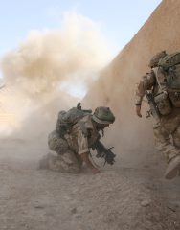
CRITICAL TO SURVIVING
THE REALITIES OF WAR

Slide 12
THE MILITARY FAMILY
A ‘Family’ that can always be relied upon for support in time of need.
The family that provides a home, food, a salary, healthcare, leisure pursuits, pastoral care and socialisation.
This is all achieved within a fixed routine – with someone instructing on what to wear, where to go and what to do.
Most military personnel and their families live on base – living, working, playing and socialising together.

Slide 13
OCCUPATIONAL IMBALANCE: PROS & CONS
Military life and it’s expectations and responsibilities, lead to occupational imbalance which is mainly productive with little time/resources for self-care or leisure.
There are the expectations to replace usual occupations with productive roles of duties in service.
It is heavily focused on teamwork and occupations are completed collectively (meals, living, protection, patrols, socialising, etc.)
Due to training and tours there can be limited family life/contact and they are not able to undertake normalised occupations.
Due to the system most recruits do not learn basic life skills such as budgeting, cooking, how to rent accommodation, register with a GP or write a CV.
Military training facilitates the creation of loyal teams - recruits develop a ‘bond that transcends all others, even the marriage and family bonds we forge in civilian life’.

Slide 14
OCCUPATIONAL IMBALANCE: PROS & CONS
However, military culture also offers a sense of belonging, a higher status, increases expectations of oneself and instil high moral values.
Servicemen and women become very skilled at specific tasks/jobs and develop leadership and problem-solving abilities.

Slide 15
STRENGTHS THAT
MILITARY SERVICE
MAY FOSTER
Commitment to excellence
Team work
Global outlook
Good time keeping
Commitment to serving others
Ability to work well within a hierarchy
‘Can-do’
attitude
There are
many more…
what strengths would you add to this list?

Slide 16
STRENGTHS MAY ALSO TRIP US UP….
‘Can-Do’ Attitude
Perfectionism
Commitment to Excellence
Drive to give 110% when 80% is ok
Ability to work well within a hierarchy
Uncertainty when hierarchy isn’t obvious or relevant
Frustration when others don’t respect lines of authority
Frustration with others who are happy with ok
Tendency towards overwork / workaholism

Slide 17
PART 2.1:
ENCOUNTERING TRAUMA
DURING EARLY LIFE & SERVICE
Trauma / adversity encountered during early life
Trauma encountered during service

Slide 18
ADVERSE CHILDHOOD EXPERIENCES
ARE COMMONLY REPORTED
International researchers, over 10+ years, have demonstrated that 67% of the population have experienced at least one adverse childhood experience (ACE).
Our own research (Ross, Armour & Murphy, 2020) into childhood adversities in UK treatment-seeking military veterans.
97% of veterans in the study reported experiencing at least one ACE (n=386 veterans).
Ross J, Armour C, Murphy D., 2020, Childhood adversities in UK treatment-seeking military veterans. British Journal of Military Health.

Slide 19
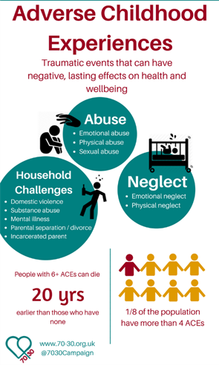
Foege WH. Adverse childhood experiences: A public health perspective. Am J Prev Med. 1998;14:354–355.

Slide 20
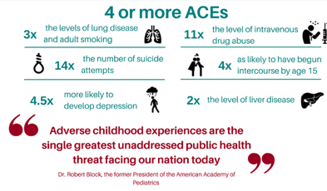
Foege WH. Adverse childhood experiences: A public health perspectivee. Am J Prev Med. 1998;14:354–355.

Slide 21
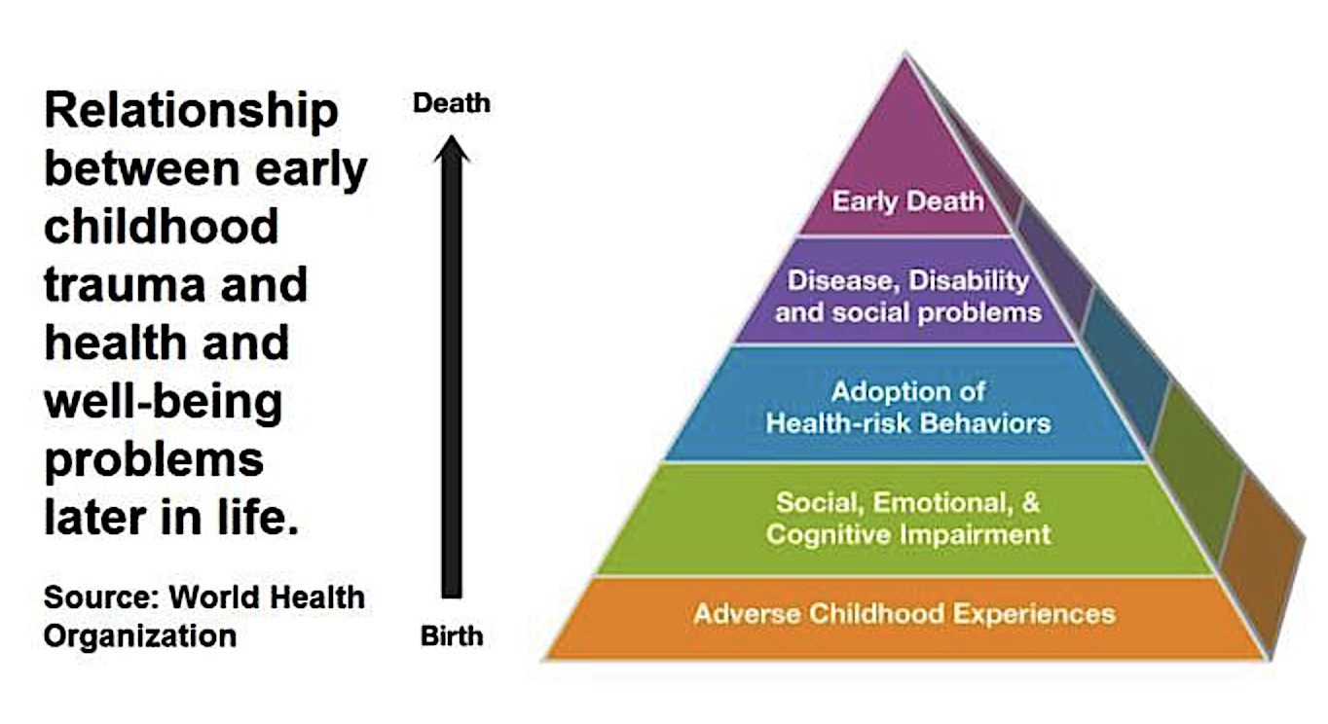
Foege WH. Adverse childhood experiences: A public health perspectivee. Am J Prev Med. 1998;14:354–355.

Slide 22
A MOMENT TO REFLECT…
  What are your thoughts about the role of Adverse Childhood Experiences?
  Is this body of research familiar or new to you?

Slide 23
A LIFE DEFINING DECISION
The military can be an attractive opportunity for many
The Armed Forces often recruit young people living in socially disadvantaged areas
There are various factors that can influence the decision to join:
  A desire to break free from current circumstances
  Lack of employment opportunities
  The desire to make a positive change to life pathways
  Wanting to find structure
  There may also be some ‘unvoiced’ motivations….

Slide 24
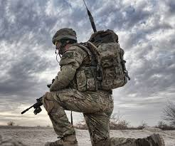
UNVOICED MOTIVATIONS
Wanting to work through or conquer the difficulties from the past
Get away from difficult family dynamics
Want to step into a hero or rescuer’s identity
An emotional
desire to belong
to a supportive group / family
Repairing the past;
wanting to prove
self-worth and value

Slide 25
PART 2.2:
ENCOUNTERING TRAUMA DURING EARLY LIFE & SERVICE
Trauma / adversity experienced during early life
Trauma encountered during service

Slide 26
TRAUMA EXPERIENCED
DURING MILITARY SERVICE
It is a myth that all Armed Forces personnel suffer from
mental health difficulties
Those that encounter conflict are likely to be psychologically impacted by it; however the majority do not experience
long-lasting mental health wounds as a result of their service.
Most experience service and deployment as a highly
positive experience

Slide 27
DEALING WITH TRAUMA
Compartmentalising memories and experiences
Support from comrades, unit
Veterans integrate their experiences of trauma using a range of ways of coping
Staying focussed on the next goal/action
Humour & camaradarie
Distraction
Alcohol or substance use
Psychological decompression

Slide 28
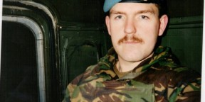
TRAUMA EXPERIENCED DURING MILITARY SERVICE
“It takes a second for something
To enter your head
But a lifetime for it to leave” Rich
Multiple military traumas are frequent
Hidden / unvoiced traumas
Military families – intergenerational impact of trauma
Hunt, E.J.F., Wessley, S., Jones, N, Rana, R, Greenberg, N. (2014). The Mental Health of the UK Armed Forces: Where Facts Meet Fiction. European Journal of Psychotraumatology, 23617, 1-15.

Slide 29
INCIDENCE OF MENTAL HEALTH DIFFICULTIES
A small but significant proportion of veterans need mental health support
For the first time, the rate of PTSD among veterans is higher than the rate of PTSD among serving personnel and the general public.
PTSD is more prevalent than alcohol misuse among veterans who served in a combat role in Iraq and/or Afghanistan.
The rate of PTSD among all UK veterans is 7.4%.
The rate of common mental health conditions among all UK veterans is one in five (21.5%).
Difficulties include depression, anxiety, alcohol / substance use, anger problems
Stevelink, S.A et al (2018). Mental health outcomes at the end of the British involvement in the Iraq and Afghanistan conflicts:
a cohort study. The British Journal of Psychiatry, 213, 690-697.

Slide 30
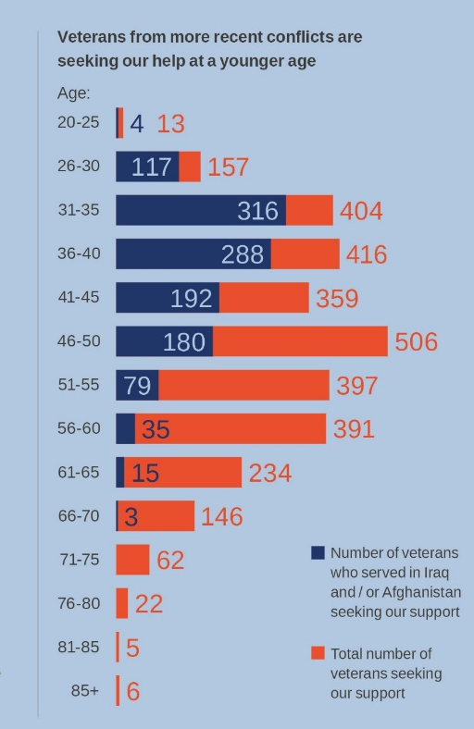
THE IMPORTANT ROLE OF STIGMA
Our own research shows that veterans are coming forward sooner to access support for their mental health
The Armed Forces are shifting the culture around mental health: TRIM assessments available and advertising mental health support through the welfare units.
The UK is slowly moving towards a more open culture about the impact of mental health struggles amongst all
“I didn’t want to show any weakness in front of the others”
Dean, served in the Army for seven years

Slide 31
PART 3:
THE IMPORTANCE OF TRANSITION FROM MILITARY TO CIVILIAN LIFE

Slide 32
SHARING SOME EXPERIENCES…
“I’ve spent my entire
adult life planning for
or actually participating
in combat.”
“What am I supposed
to do now?”
“I can’t just turn
around and
start over…”
Burleson, E. (2019). Separating From Service: The Mental Health Handbook for Transitioning Veterans. Varime, LLC, Texas, USA.

Slide 33
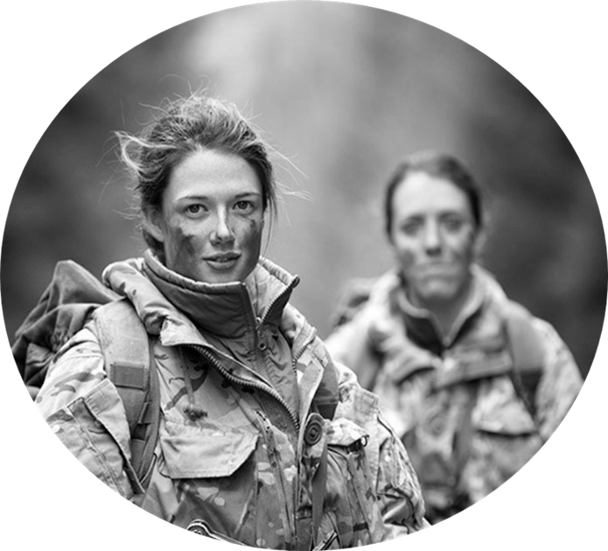
DIFFICULTIES TRANSITIONING
FROM THE MILITARY
Most veterans leave the military with good psychological health
A small but significant proportion struggle
What kind of difficulties may be experienced?

Slide 34
Transitioning from the military to civilian life…
Dealing with injuries: physical, emotional, moral.
Loss of friendships with peer group
Potential money /housing concerns
Adjusting to shared life with a partner/family has both pros and cons
Finding it difficult to talk about experiences: ‘How can they understand?’
Adapting to life without a structure/set routine/ accountability
Lack of a ‘mission’ can create a void that needs to be filled with overwork
Dealing with grief of lost comrades, separating from service
Possible difficulties finding suitable employment
Skills from military life may not easily translate to civilian jobs

Slide 35
‘A REVERSE CULTURE SHOCK’
‘Service Life and Beyond – Institution or Culture?’ Bergman, Greenberg et al (2014)
Moving from the military family to the civilian world may be experienced as a second culture shock
It is estimated that 6% of veterans struggle to adjust to life as a civilian
Life skills such as budgeting, cooking, organising accommodation, registering with a GP, writing a CV – each of these may be new skills to develop

Slide 36

LIFE SKILLS, PREPAREDNESS &
READINESS FOR CIVILIAN LIFE
As many as 6 out of 10 veterans disengage from support services
Murphy, D, Busuttil, W. (2019). Understanding the needs of veterans seeking support for mental health difficulties Journal of the Royal Army Medical Corps

Slide 37
WHAT FACTORS CAN INFLUENCE TRANSITION AND WELLBEING?
Military / lifespan trauma
Social Isolation
Financial /
Material
Poverty
Poor Housing/ Physical Environment
Poor Mental Health
Poor Physical Health
Lack of Employment
Reasons for discharge
Age and length of service
Preparedness for Civilian Life

Slide 38
‘SEPARATING’
FROM SERVICE
“Separating from the military is a traumatic event. That doesn’t mean it’s negative; for most veterans, the separation event is a positive change. But the change disrupts almost every facet of life in some way, and the upcoming change and the change itself often causes anxiety, worry, pain/discomfort, and sadness or depression…. Difficulty in transition has nothing to do with how capable you are – and everything to do with how human you are.”
Eric Burleson, Author of
‘Separating From Service.’
Burleson, E. (2019). Separating From Service: The Mental Health Handbook for Transitioning Veterans. Varime, LLC, Texas, USA.

Slide 39
MILITARY LIFE VS CIVILIAN LIFE
Negotiating the demands of civilian life often requires:
Identify the problem
Identify the options
Communicate the options
Decide with others
Implement solutions
Depending on a veterans’ service experience, they may have had little need or opportunity to undertake many of these tasks
When they did have opportunities, there may have been only a narrow choice of pre-defined options
For example, “Hey mate” is not an acceptable way to address an officer
Civilian life is much more nuanced
Burleson, E. (2019). Separating From Service: The Mental Health Handbook for Transitioning Veterans. Varime, LLC, Texas, USA.

Slide 40
THE GOAL OF INTEGRATION
A notion of becoming part of the civilian communities in which a veteran lives.
A noble goal, but seems to attempt to make veterans more like civilians, or at least less like service-members
“To try and make us less like our former selves is an insult”
“Goal is to take our histories in the military and make them a part of our whole self”
Burleson, E. (2019). Separating From Service: The Mental Health Handbook for Transitioning Veterans. Varime, LLC, Texas, USA.

Slide 41
SUPPORTING TRANSITION FROM MILITARY TO CIVILIAN LIFE

Slide 42
SUPPORTING TRANSITION
Employment:
www.Cobseo.org.uk
Your organisations
are playing a vital role.
Networking with your PPP
colleagues can strengthen
your existing network.
”The real-life skills we learn over a military career are priceless. The ability to turn up to a job on time, dressed correctly, with the right attitude and to go the extra mile. These are skills that do not get taught they are instilled in the life of a soldier.” www.CTP.org.uk
Refer back to ideas from Module 1, e.g. the areas of resilience
Relationships:
- with other veterans & civilians, for support & advocacy
- Buddy support
Seek referral for mental heath support
Including NHS, Combat Stress etc
Advocacy services –
housing, finances,
Criminal justice
system.

Slide 43
SERVICES THAT COMBAT STRESS PROVIDE:
24/7 Helpline:
Free help and advice for veterans and their families
0800 138 1619
Interdisciplinary support across the UK: (Occupational Therapy, Nursing, Psychology, Psychiatry)
Psychological Therapy:
Online / phone
Digital and online support & education:
combatstress.org.uk
Buddy Buddy
Support Service
Support for partners and family members
Visit our website for self-help guides to support with a range of issues: combatstress.org.uk/mental-health-support-during-covid-19

Slide 44
PAUL SHARES HIS STORY…
“On that very first call, just talking to someone really helped. I was reassured it was OK to feel this way. I began weekly one-to-one therapy sessions. I learnt different techniques to cope with my feelings and experiences. It was an emotional roller coaster, but it was a very good and thorough process.
“Life has definitely changed for the better.
“It’s taken 20 years for me to come to terms with my experience but I’ve made sense of it now. Before I got help from Combat Stress, if any event triggered my PTSD response the world would immediately become a very dark place, but that’s no longer the case.”
Thank you to Paul for sharing his story with us.

Slide 45
A MOMENT TO REFLECT…
What is your top take-away
for yourself / your organisation?
What are your
1-3 actions/next steps for yourself / your organisation?

Slide 46
SUMMARY, QUESTIONS & NEXT STEPS
1
Question & Answer time
2
What’s one takeaway or action step for yourself / your project?
3
This is module 2 of 4, we will build on these ideas in future modules
4
Self-assessment quiz and certificate of attendance
5
Evaluation and Feedback: https://www.surveymonkey.co.uk/r/CSTandE2
Thank you for your time, attention & commitment to support veterans in your organisation

Slide 47
ACKNOWLEDGEMENTS
*
Special thanks to our co-authors: Jolandi du Preez (Lead Occupational Therapist), Naomi Wilson (Consultant Clinical Psychologist and Head of Psychological Therapies), Walter Busuttil (Consultant Psychiatrist and Medical Director) Jen Bateman (Clinical Psychologist) and all contributors from the Combat Stress National Veterans’ Voice.
*
Thank you to all Combat Stress colleagues who contributed to the development of this training.
*
Sincere thanks to the Armed Forces Covenant Fund Trust for their generous funding of this programme and to the Strategic Partners for all their support

Slide 48
REFERENCES
1
Ross J, Armour C, Murphy D., 2020, Childhood adversities in UK treatment-seeking military veterans. British Journal of Military Health, doi: 10.1136/jramc-2019-001297
2
Foege, W.H. (1998). Adverse childhood experiences: A public health perspective. American Journal of Preventative Medicine;14:354–355.
3
Murphy D, Palmer E, Busuttil W (2016) Exploring Indices of Multiple Deprivation within a Sample of Veterans Seeking Help for Mental Health Difficulties Residing in England. Journal of Epidemiology & Public Health Reviews 1(6) doi http://dx.doi.org/10.16966/2471- 8211.132.
4
Stevelink, S.A et al (2018). Mental health outcomes at the end of the British involvement in the Iraq and Afghanistan conflicts: a cohort study. The British Journal of Psychiatry, 213, 690-697.
5
Murphy, D, Busuttil, W. (2019). Understanding the needs of veterans seeking support for mental health difficulties Journal of the Royal Army Medical Corps, 10.1136/jramc-2019-001204.
6
Hunt, E.J.F., Wessley, S., Jones, N, Rana, R, Greenberg, N. (2014). The Mental Health of the UK Armed Forces: Where Facts Meet Fiction. European Journal of Psychotraumatology, 23617, 1-15.
7
Burleson, E. (2019). Separating From Service, Varime, LLC, Texas, USA.

Slide 49
REFLECTION QUESTIONS:
1
What are some of the strengths of military life? What are some of the vulnerabilities?
2
  What are your thoughts about the role of Adverse Childhood Experiences? Is this body of research
  familiar or new to you?
3
What is your top take-away for yourself / your organisation?
What are your 1-3 actions/next steps for yourself / your organisation?

