Slide 1
PSYCHOLOGICALLY-INFORMED SUPPORT FOR TEAMS DURING COVID-19
Dr Jen Bateman Lead Clinical Psychologist

Slide 2
COPYRIGHT INFORMATION
© Combat Stress 2020
This presentation is for your individual use only.
It is not to be circulated or shared outside of your organisation.

Slide 3
WELCOME & INTRODUCTIONS
Facilitator: Dr Jen Bateman, Lead Clinical Psychologist
With thanks to co-authors Jolandi du Preez, Lead Occupational Therapist, Naomi Wilson, Consultant Clinical Psychologist and Walter Busuttil, Consultant Psychiatrist for their valuable input into the development of this material.

Slide 4
AGENDA
The unique challenges of Care Home Workers
Understanding and managing the emotional responses to COVID-19: frameworks to guide you
Providing the appropriate level of support to your team
Knowing when to refer for psychological support
Actions and next steps

Slide 5
A MOMENT TO REFLECT…
What are your current experiences and challenges?
What are you doing well?
What do you need
support with?

Slide 6
THE UNIQUE CHALLENGES OF CARE HOME WORKERS

Slide 7
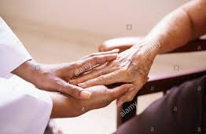
THE UNIQUE CHALLENGES OF CARE HOME WORKERS:
Use of PPE can make communication & connection harder
Close relationships ending without usual ways of saying goodbye
Vulnerable to infection. Adequate PPE?
Competing personal and professional demands
Demands of high care needs may outstrip training and experience
Residents will require more support: practically and emotionally
A need to make difficult decisions where there are no ‘right’ answers
Multiple experiences of losses and grief
From The COVID Trauma Response Working Group (https://www.traumagroup.org)

Slide 8
UNDERSTANDING THE RANGE OF EMOTIONAL RESPONSES

Slide 9
THE RANGE OF EMOTIONS & RESPONSES
Unprecedented work in unprecedented times
It is okay to not be okay
Emotions provide important information
Normalising the range of emotions you and others may be experiencing
All emotions are important; positive or negative

Slide 10
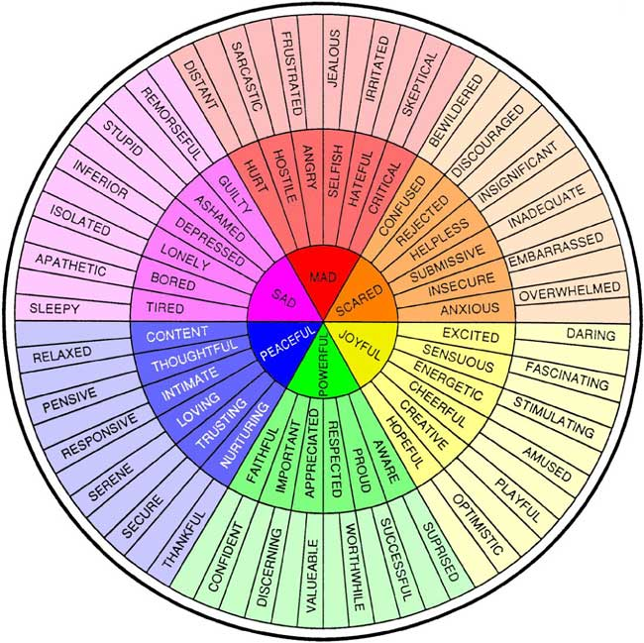
THE FEELINGS WHEEL
Roberts, Geoffrey, accessed online June 2020 from https://imgur.com/q6hcgsH

Slide 11
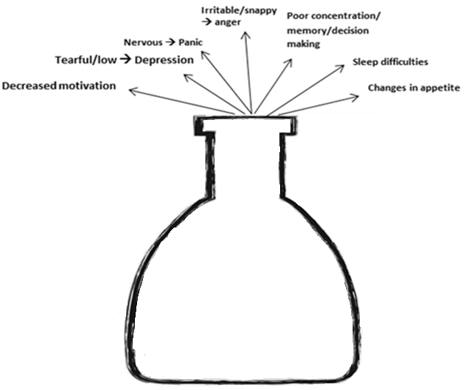
THE STRESS BOTTLE
Small every day stress
Finances
Grief
Lock-Down
Home Stress
Distress at work
Health / Risk Concerns
Past Events
Adapted from Sherwood Forest Hospital NHS Trust: https://www.sfh-tr.nhs.uk

Slide 12
PROVIDING PSYCHOLOGICAL SUPPORT TO STAFF DURING COVID-19

Slide 13
PROVIDING SUPPORT TO STAFF
A ‘stepped’ approach is recommended:
Support/Psychological First Aid
Information
Basic Needs & Physical Resources
Psychological intervention (e.g. 1:1 Therapy)
The British Psychological Society (2020) Guidance for psychological professionals during the COVID-19 pandemic

Slide 14
COVID-19: 3 PHASES OF PSYCHOLOGICAL RESPONSE

Slide 15
COVID-19: 3 PHASES OF RESPONSE There are 3 likely phases of Psychological Response In Healthcare Workers:
Preparation Phase
Action Phase
Recovery Phase
The British Psychological Society (2020) Guidance for psychological professionals during the COVID-19 pandemic

Slide 16
PHASE 1: PREPARATION PHASE
Likely Experience:
Anticipatory Anxiety
Rapid, high level planning
Fear of the unknown
Not feeling prepared
The British Psychological Society (2020) Guidance for psychological professionals during the COVID-19 pandemic

Slide 17
PHASE 2: ACTION PHASE I
Likely Experience:
Heroics & Surge to a Solution
Increased camaraderie
More prone to error
Staff witness new stressors, feel out of control
Work-life tensions
The British Psychological Society (2020) Guidance for psychological professionals during the COVID-19 pandemic

Slide 18
PHASE 2: ACTION PHASE II
Likely Experience:
Disillusionment& Exhaustion
The period of highest risk
Moral/ ethical conflicts
Risk to those with pre-existing mental health vulnerabilities
Compassion Fatigue
Adrenaline then exhaustion
The British Psychological Society (2020) Guidance for psychological professionals during the COVID-19 pandemic

Slide 19
PHASE 3: RECOVERY
Likely Experience:
Recovery & Long Term Psychological Impact
Time to reflect, use existing coping skills
Intrusive Thoughts, Shame, Guilt
Risk of long-term mental health difficulties
Resentment towards organisation
Dissonance with ‘heroes’ narrative
The British Psychological Society (2020) Guidance for psychological professionals during the COVID-19 pandemic

Slide 20
A MOMENT TO REFLECT…
Reflecting on these stages, what is your understanding of the phase you and your staff are currently in?
Phase 1: Preparation
Phase 2: Action
Phase 3: Recovery

Slide 21
A MOMENT TO REFLECT…
What do you need now, individually and as a team?
Consider discussing and reflecting with your team after this webinar.

Slide 22
PRACTICAL STRATEGIES TO MANAGE STRESS
Small every day stress
Eat, drink and sleep properly
Maintain a routine
Regular breaks during shifts
Time out between shifts
Engage in physical activity
Plan regular, feel good activities
Stay in touch with friends/family
Avoid unhelpful coping strategies
Limit time engaging with news
Engage with activities that takes mind away from current crisis.
Finances
Grief
Lock-Down
Home Stress
Distress at work
Health / Risk Concerns
Past Events
Adapted from Sherwood Forest Hospital NHS Trust: https://www.sfh-tr.nhs.uk

Slide 23
RECOGNIZING SIGNS OF ANXIETY & EMOTIONAL DISTRESS

Slide 24
SIGNS A COLLEAGUE MAY NEED MORE EMOTIONAL SUPPORT
Appearing more anxious / ‘on edge’
More prone to irritability or anger
Lower in mood than usual
Seeming more withdrawn than usual
Being more forgetful
Little interest in doing things
Reports lethargy/fatigue or trouble relaxing or sleeping
Greater self-criticism or a sense of hopelessness
Trouble concentrating
Finding fault/being cynical and resentful
Generally less productive
Change in work patterns – starting late/leaving early/excessive long hours
Reporting using alcohol or substances more often to cope

Slide 25
PROVIDING EMOTIONAL SUPPORT TO COLLEAGUES (STAFF TO STAFF)
If a colleague is showing any signs that cause you concern:
Be willing to have the conversation
Make time for 1:1 conversation
Ask the question ‘How are you?’
Listen actively and show empathy
Discuss the advantages of seeking extra support to promote mental wellbeing at this time.
Seek help yourself if you are unsure what to advise
Remember your own self-care

Slide 26
RECOMMENDATIONS FOR SUPPORTING CARE HOME WORKERS DURING COVID-19

Slide 27
RECOMMENDATIONS FOR SUPPORTING CARE HOME WORKERS DURING COVID-19:
1. Provision of Basic Needs
PPE, food, rest, shift patterns
Staff financial insecurity?
2. Information About COVID19
Brief, clear, honest, accessible
3. Effective Communication, Camaraderie and Social Support
Informal Peer/Buddy Support
Camaraderie/connection/feedback
Infection control, care & training
The COVID Trauma Response Working Group (https://www.traumagroup.org)

Slide 28
4. Support Psychological Wellbeing
Compassionate attention
Normalise, don’t minimise distress
5. Grief and Bereavement Training/Support
Helplines/leaflets
Reminiscence & reassurance
6. Encourage Self-Care
Physical self care, enjoyment
Connection: social & news
RECOMMENDATIONS FOR SUPPORTING CARE HOME WORKERS DURING COVID-19:
The COVID Trauma Response Working Group (https://www.traumagroup.org)

Slide 29
PROVIDING EMOTIONAL SUPPORT TO COLLEAGUES (LEADERS TO STAFF)
Role Model:
Self care
Share experiences
Acknowledge difficulties
Celebrate good practice
Provide compassionate and supportive management:
Pay attention and listen to staff
Recognise and appreciate work with positive feedback
Be understanding when things go wrong under pressure
Normalise but don’t minimize distress
Encourage to seek help if needed:
Enable staff to access online resources, helplines and wellbeing apps
Know what’s available in local area and inform staff

Slide 30
PROVIDING EMOTIONAL SUPPORT IN THE WORKPLACE (LEADERS TO STAFF)
Dispel feelings of failure, blame, shame “I’m here to support you, we’ll find a way through together”
Show empathy
“What you’re going through sounds really tough.”
Normalise that expression of emotion is healthy “You’ve been through such a lot, thank you for sharing this with me.”
“How can I / we best support you? What needs to happen for you to feel more at ease? What has helped in the past?”
Consider and
check in regarding confidentiality of information shared
Consider organisational needs regarding employee wellbeing and record keeping
Fostering Strengths of Your Team
Focus on what CAN be controlled
Self-Compassion & Kindness

Slide 31
SIGNPOSTING FOR FURTHER SUPPORT
Our Frontline: www.Mentalhealthatwork.org.uk/ourfontline offers frontline, care and key worker staff round the clock 1:1 support by call or text by trained volunteers.
The Big White Wall https://www.bigwhitewall.com An online peer-to-peer support community for your mental health
MIND https://www.mind.org.uk/ Information and support for mental health and wellbeing
Cruse Bereavement Support https://www.cruse.org.uk/ COVID19 specific guidance
Explore some Recommended Apps:
Headfit: Tools for Mental Fitness https://headfit.org
Calm and Sleepio: Help with sleep and managing emotions
Catch It and Unmind : Support for managing unwanted thoughts and problem solving

Slide 32
ACCESSING PSYCHOLOGICAL SUPPORT
If you have concerns about your colleagues’ emotional wellbeing, encourage him/her to speak to their GP and seek a referral for appropriate psychological support.
NHS psychological support is available throughout the UK, in the form of time-limited therapy for common mental health problems such as depression and anxiety.
Encourage your colleague to ask their GP for how to get a referral for IAPT support (Improving Access To Psychological Therapies) in their area. Many areas also have an online self-referral option.

Slide 33
CONCERNS ABOUT RISK OF HARM
If your colleague tells you they have had thoughts of harming themselves, do accompany them to their GP so their mental health can be assessed by a health professional.
Accessing help via NHS 111 online or via phone is also a safe option.
Call 999 if they are in immediate risk to themselves or others.

Slide 34
STAFF TO RESIDENT SUPPORT
Consider creating small working groups across sites to share best practice/learning about overcoming specific challenges you may encounter, for example: (www.traumagroup.org/)
Working in a person-centred way whilst wearing PPE
Feeling under-prepared / under-resourced for the level of nursing or palliative care residents may need
Residents feeling more lonely, anxious and depressed at this time and finding it difficult to adjust to online contact with loved ones.
Increased frequency of dealing with deaths of residents and needing to break bad news to family members over the phone rather than in person.

Slide 35
A MOMENT TO REFLECT…
Is there anything you’ve heard today that you think may help you?
What are 1-3 next steps for
you/your team?

Slide 36
SUMMARY, ACTIONS & NEXT STEPS
This is an extremely difficult and pressured time
Do the best you can and be kind to yourself
What’s one thing you can take forward?
Feedback & evaluation via Survey Monkey: https://www.surveymonkey.co.uk/r/TrainingandQuestionForm

Slide 37
KEY RESOURCES
1.Our Frontline:
www.Mentalhealthatwork.org.uk/ourfontline offers frontline, care and key worker staff round the clock 1:1 support by call or text by trained volunteers.
2. COVID-19 Guidance and Support specifically for Care Workers:
https://www.skillsforcare.org.uk
2. Guidance for Managers and Decision Makers in Supporting Care Home Workers during COVID-19:
https://www.traumagroup.org/
3. Guidance for psychological professionals during the Covid-19 pandemic:
https://www.bps.org.uk/news-and-policy/new-guidance-psychological-professionals-during-covid-19-pandemic

Slide 38
REFERENCES
The Covid Trauma Response Working Group (2020) Guidance for Managers and Decision Makers in Supporting Care Home Workers during COVID-19. Accessed online May 2020. https://www.traumagroup.org/
The British Psychological Society (2020). Guidance for psychological professionals during the Covid-19 pandemic. Accessed online May 2020. https://www.bps.org.uk/news-and-policy/new-guidance-psychological-professionals-during-covid-19-pandemic
Roberts, G. (2015). The Feelings Wheel. Accessed online May 2020. https://imgur.com/q6hcgsH
Sherwood Forest Hospital NHS Trust (2020). The Stress Bottle, Accessed online May 2020. https://www.sfh-tr.nhs.uk/our-services/clinical-psychology-cancer-service/the-stress-bottle/

Slide 39
THANK YOU AND ACKNOWLEDGEMENTS
Sincere thanks to all the authors who contributed to the resources and guidance documents referenced within this training.
With particular thanks to Jolandi du Preez, Lead Occupational Therapist, Naomi Wilson, Consultant Clinical Psychologist, Walter Busuttil, Consultant Psychiatrist and all Combat Stress colleagues who kindly provided valuable input into the development of this material.

